Slide 1

20CSS1 Web Application Development using Full Stack - Module-I (Frontend Development)
LAKIREDDY BALI REDDY COLLEGE OF ENGINEERING (AUTONOMOUS) Accredited by NAAC & NBA (Under Tier - I) ISO 9001:2015 Certified Institution Approved by AICTE, New Delhi. and Affiliated to JNTUK, Kakinada L.B. REDDY NAGAR, MYLAVARAM, KRISHNA DIST., A.P.-521 230. DEPARTMENT OF COMPUTER SCIENCE & ENGINEERING
Program & Semester: B.Tech & III SEM
Section: CSE - B
Academic Year: 2021 - 22
Presentation Of Web Application
By
T Venkata Manikanta Rakesh
20761A05c5

Slide 2
Youtube Lite(VID TUBE)
Youtube(Vid Tube) is a free video sharing website that makes it easy to watch online videos. You can even create and upload your own videos to share with others. Vid Tube is now one of the most popular sites on the Web, with visitors watching around 6 billion hours of video every month.
If you've ever watched a video online, there's a good chance it was a YouTube video. For example, we are somany technical knowledge imformations,Educational videos,Present Updating imformation are daily uploaded in Vid Tube .
It is the one of the present latest application used by somany people around people.

Slide 3
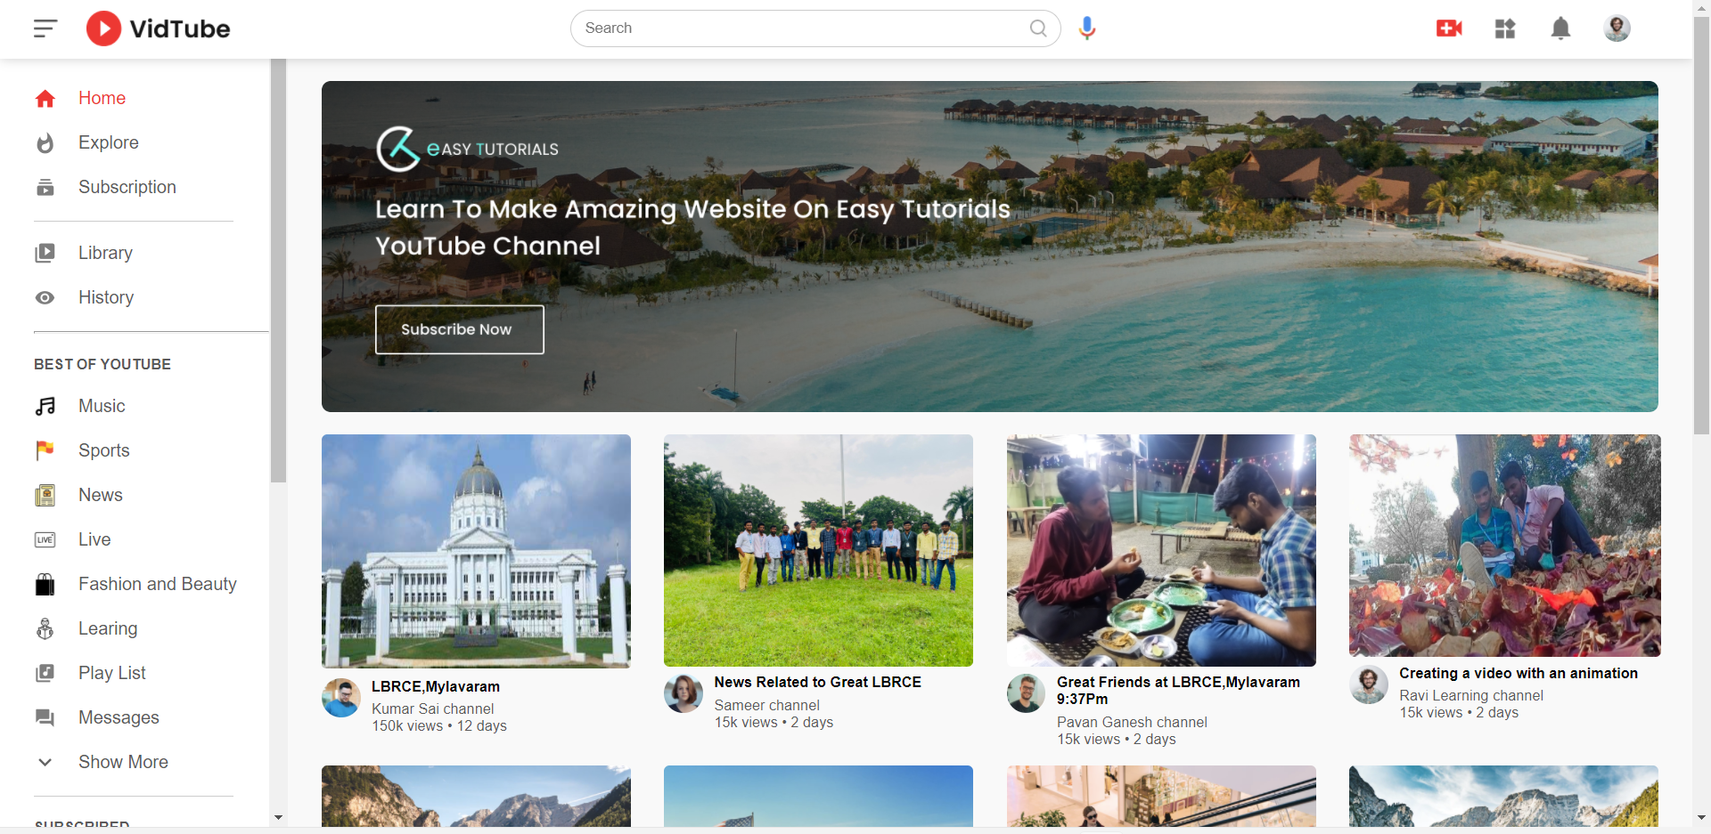
_ Normal Front End image of Vid tube

Slide 4
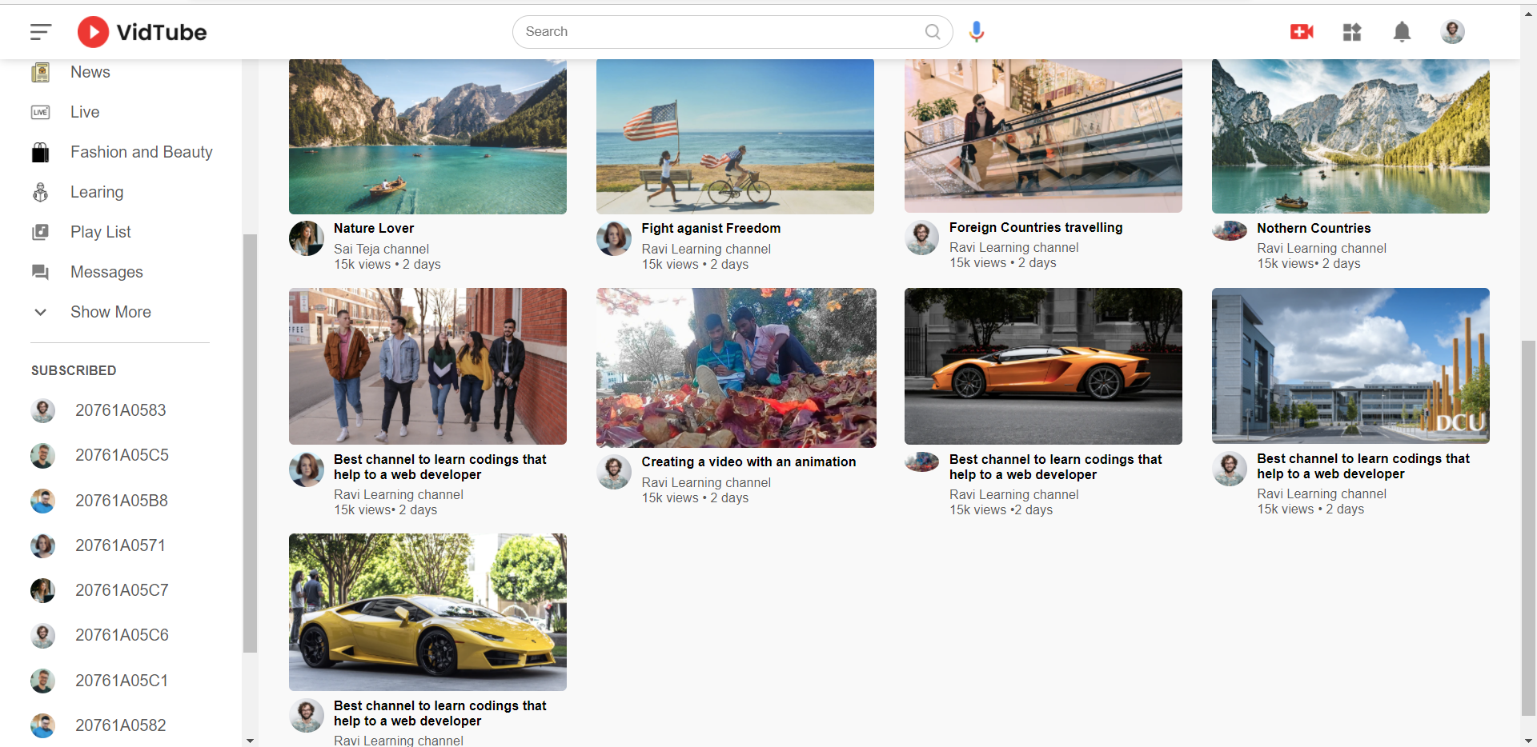

Slide 5
Mainly operations performed In VidTube
Operation on menu Bar(Minimize and maximize the size)
By pressing or clicking the photos to play a videos

Slide 6
Operation on Menu Bar

Slide 7
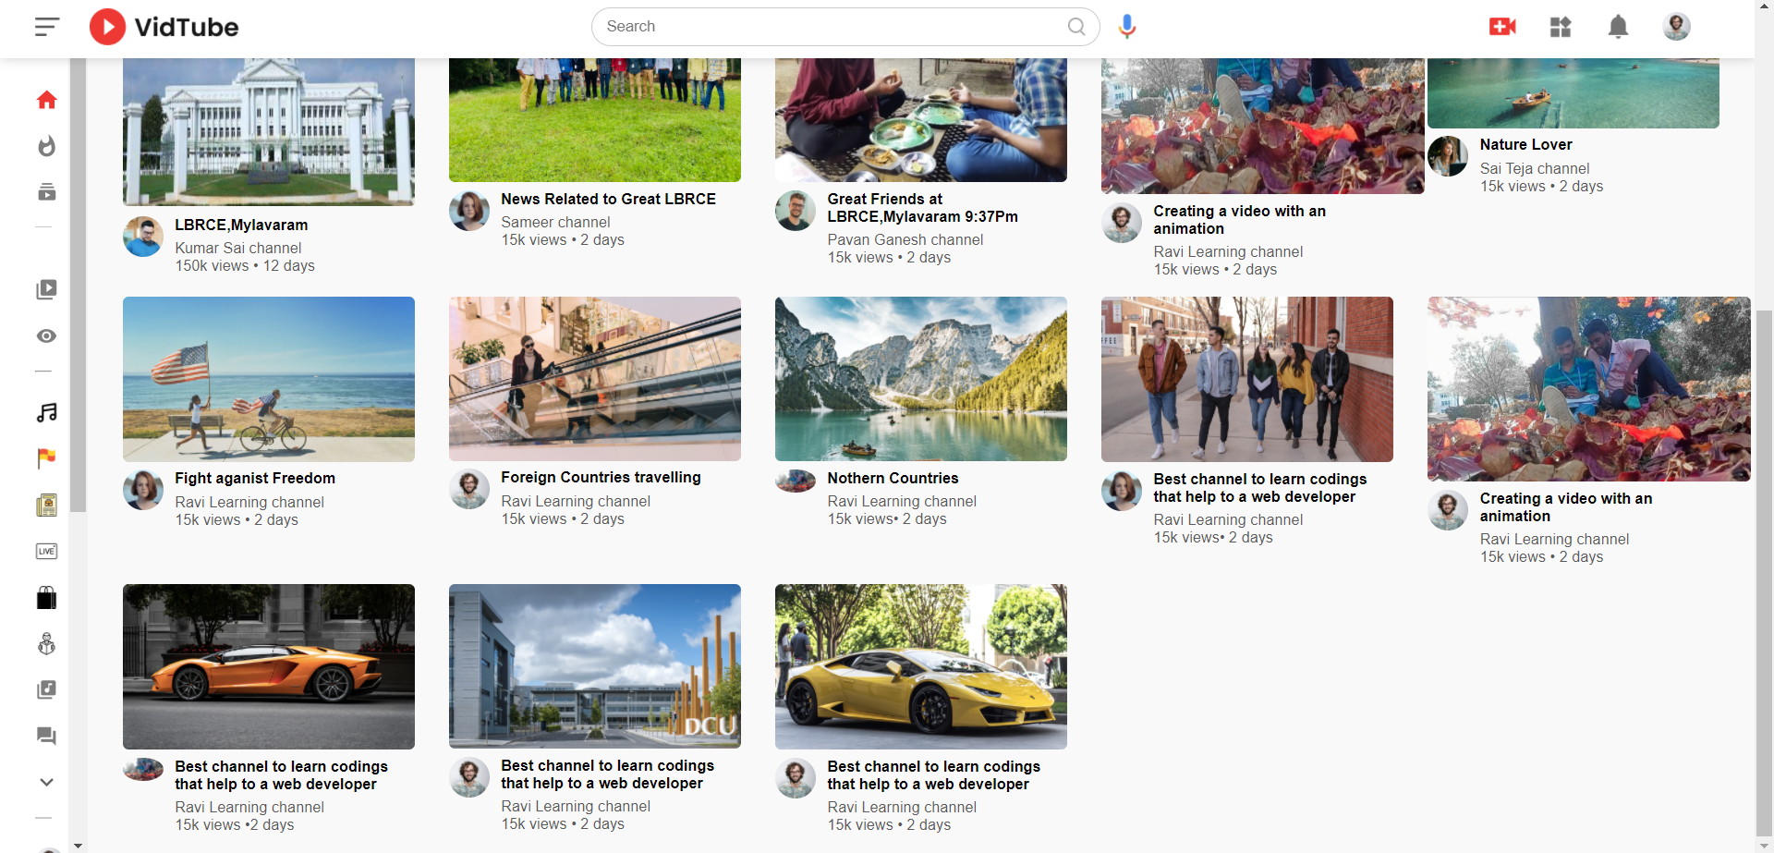
Reactions on Menu Bar

Slide 8
Playing video

Slide 9
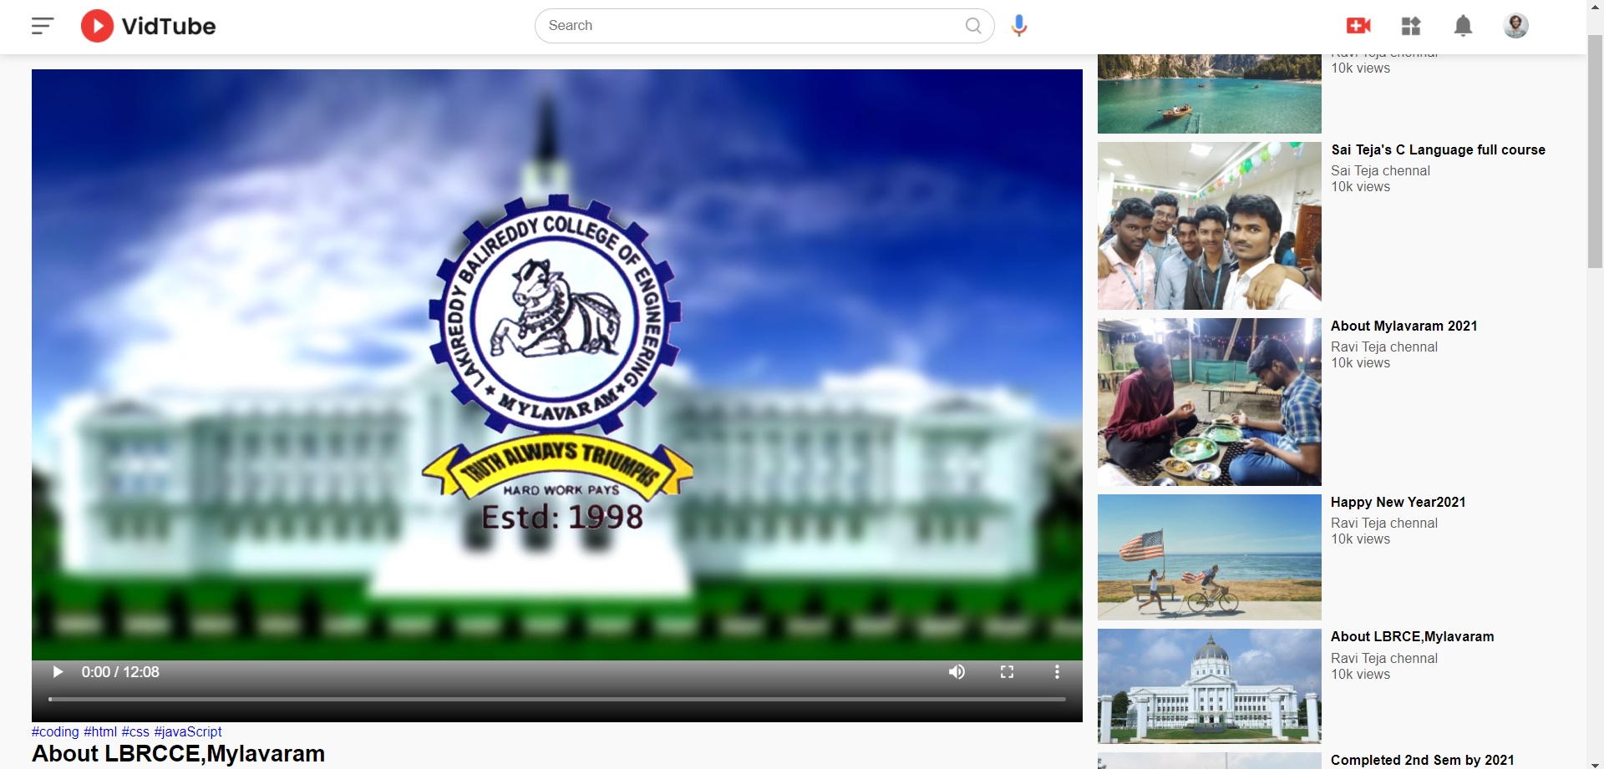
Result:

Slide 10
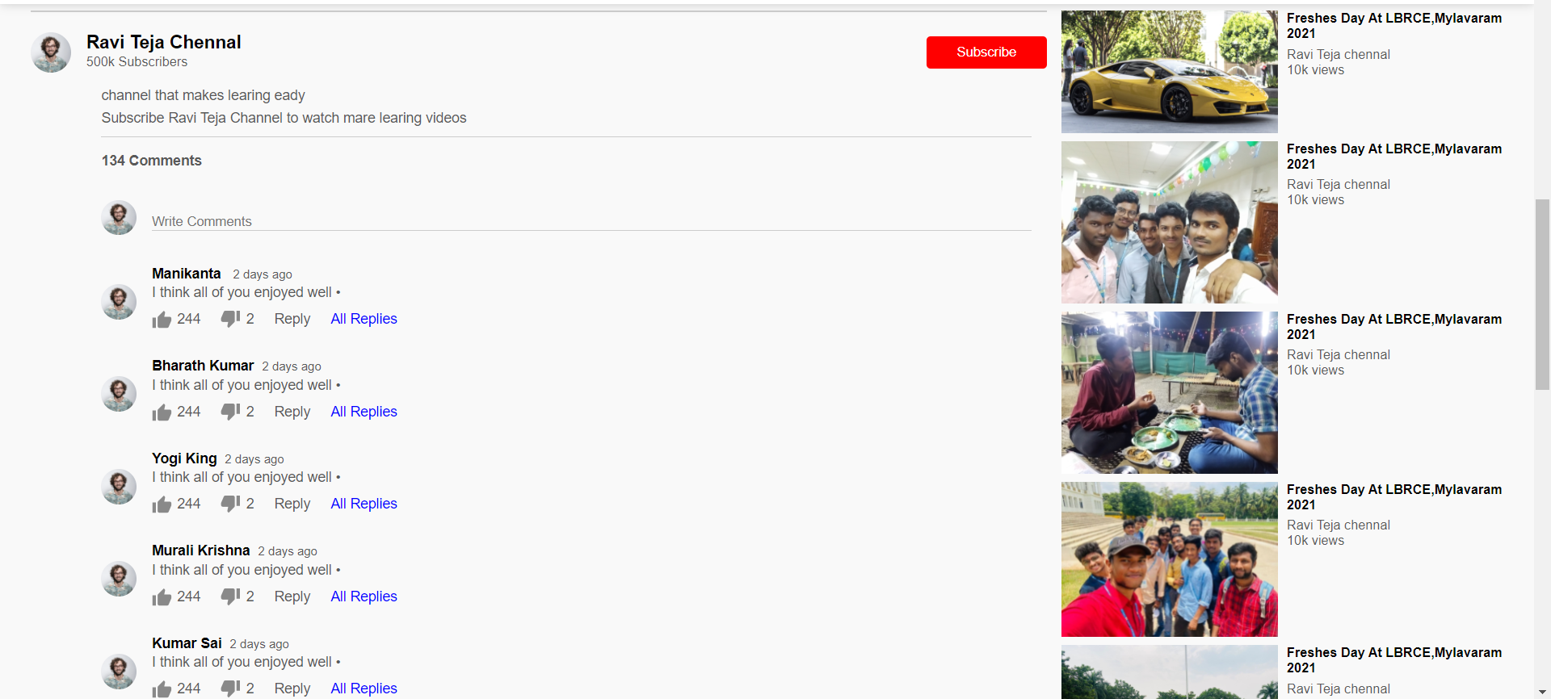
Comments Section in Playing video

Slide 11


